Slide 1

Yoga Partner
Group 5
Sarath S - 20418076
Rahul RS - 20418061
Aswin Cherukat - 14180028

Slide 2
What is YogaPartner?
Yoga Partner is an android application which assists people while doing yoga.
Using phone’s camera, the posture of the user is captured. The posture is interpreted by the application in the form of landmarks. The specific yoga asana that is demonstrated by the user is found out by the software using a ML algorithm. The name of the asana is then displayed on the screen.

Slide 3
Why YogaPartner?
User friendly design.
Ease of use.
Identify yoga asana.
Identify using phone camera.
No need of personal trainer.

Slide 4
Poster

Slide 5
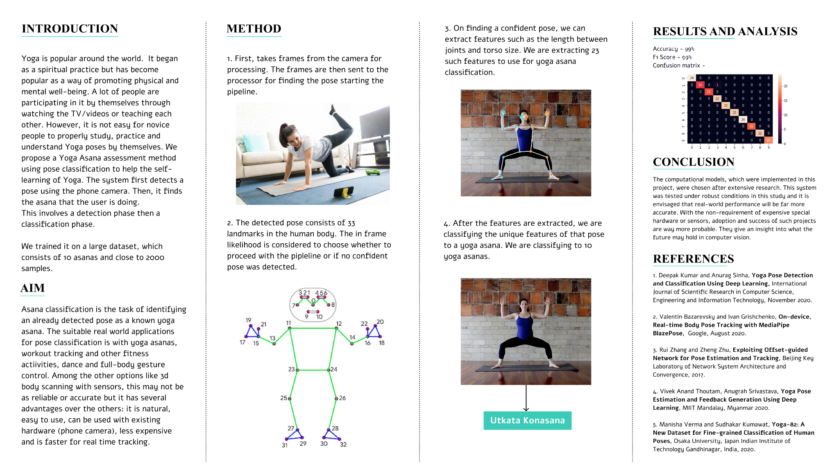

Slide 6
UML Models

Slide 7
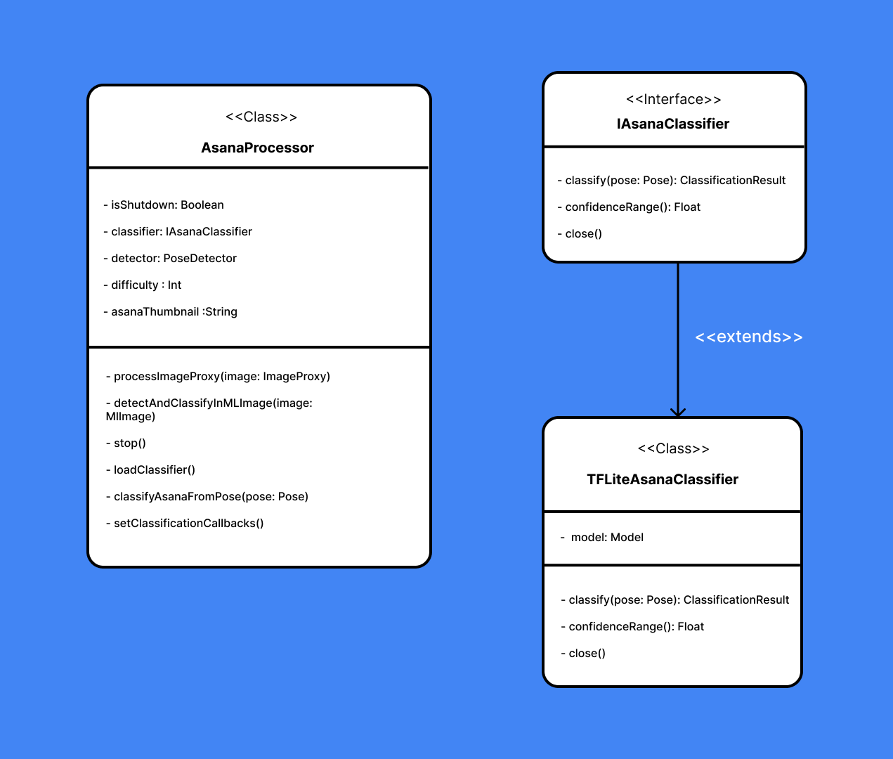
Class Diagrams

Slide 8
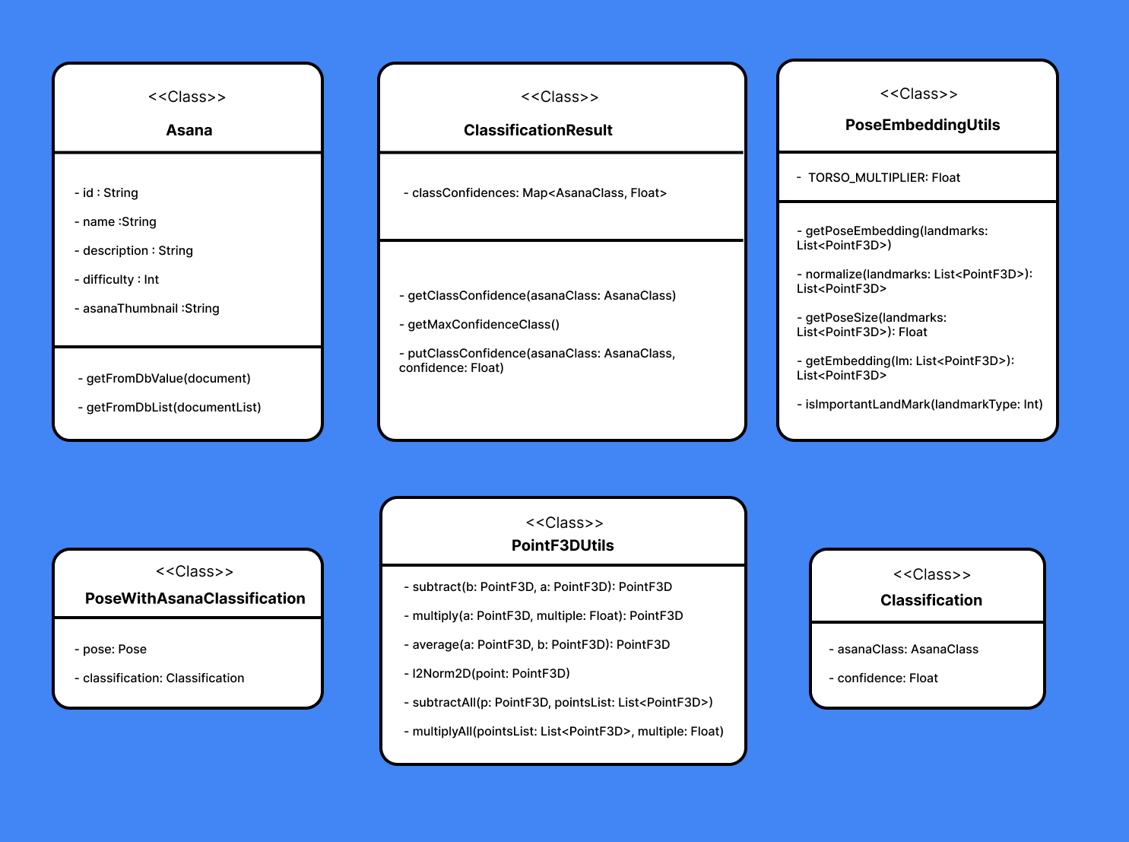

Slide 9
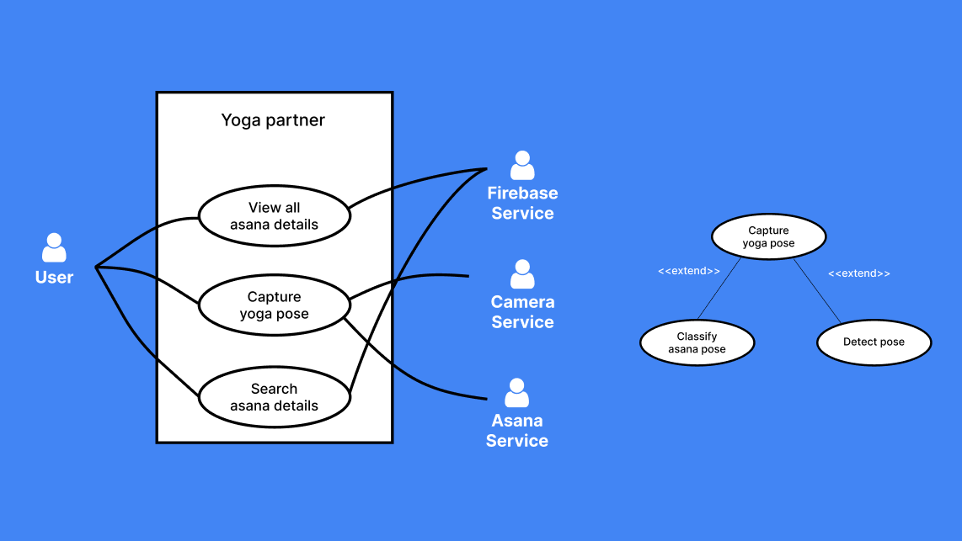
Use Case Diagrams

Slide 10
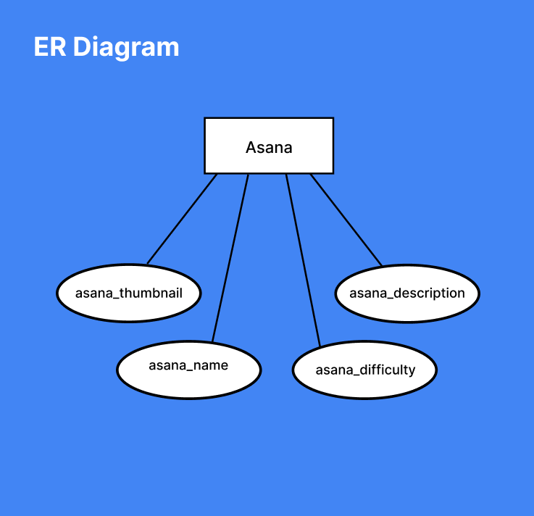

Slide 11
Result
All the modules are complete and testing was performed successfully.

Slide 12
DEMO

Slide 13
Thank You

